Slide 1
Group By
By: rakesh kumar

Slide 2
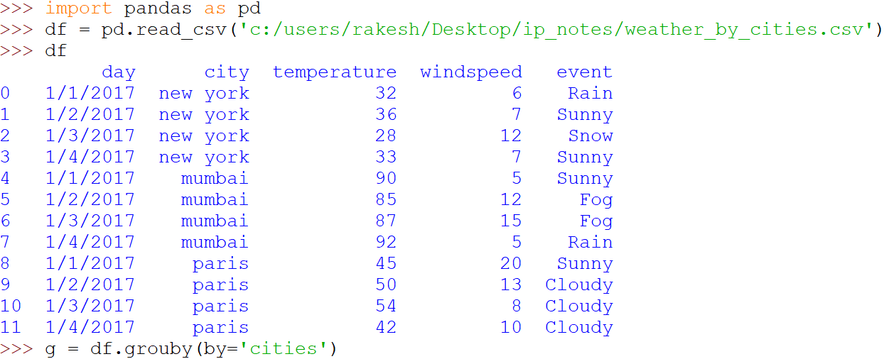
Grouping Data

Slide 3
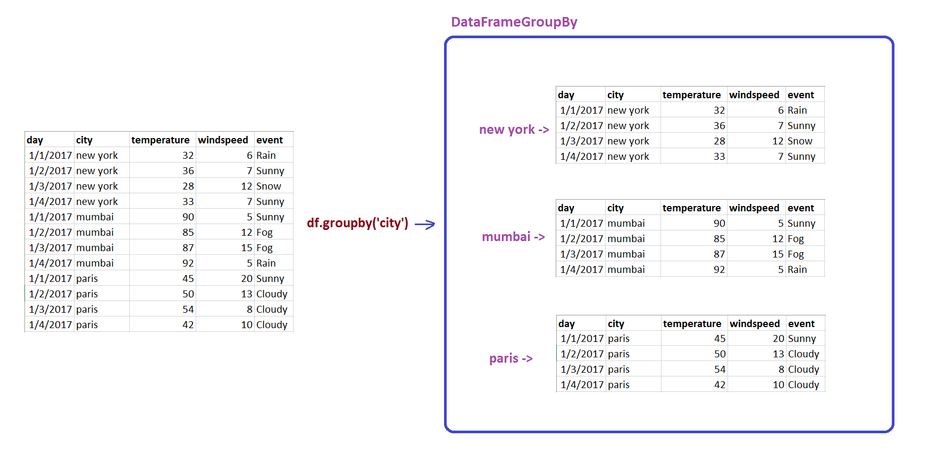
Groupby - Images

Slide 4

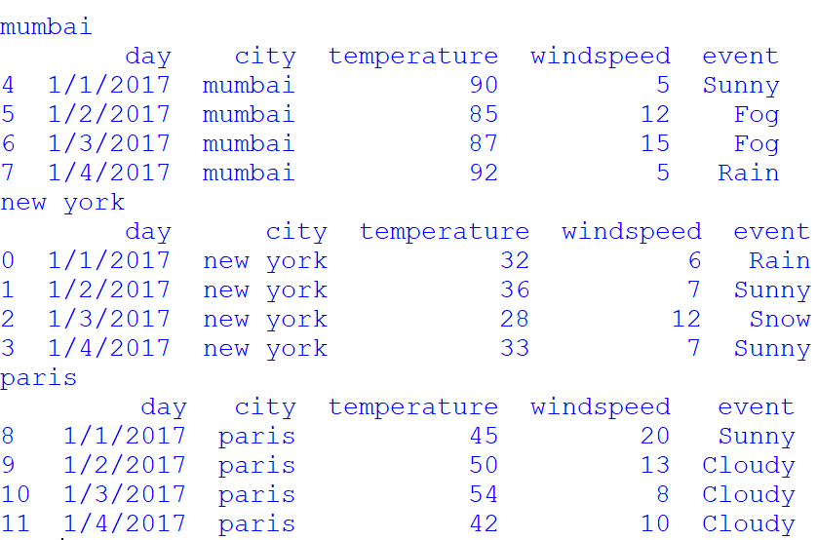
Group by - iteration

Slide 5
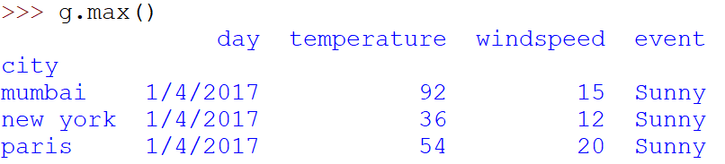
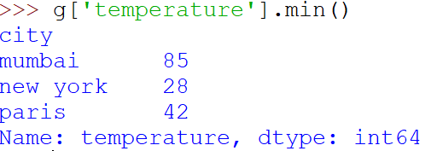
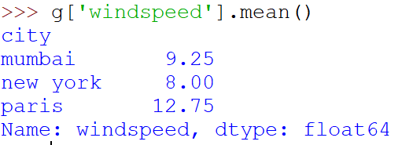
Aggregate Functions

Slide 6
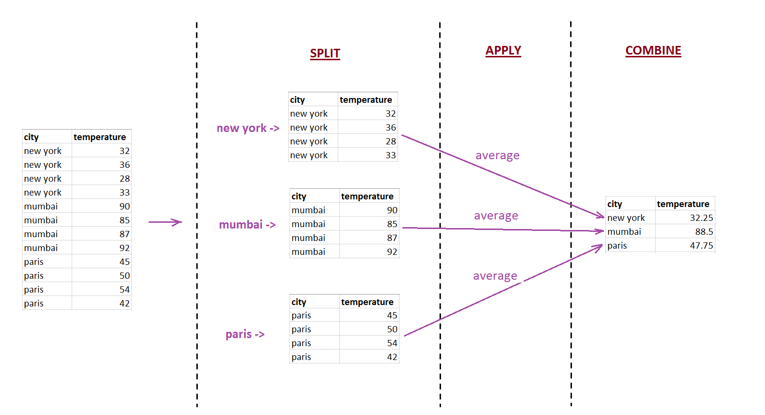
Split- Apply- Combine

Slide 7
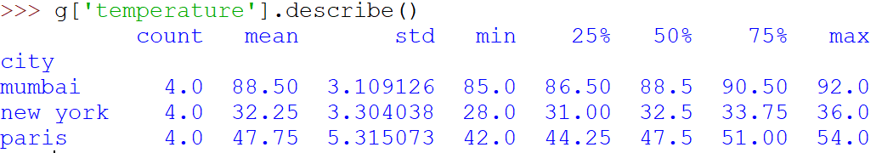
https://pandas.pydata.org/pandas-docs/stable/reference/api/pandas.DataFrame.groupby.html

